Slide 1

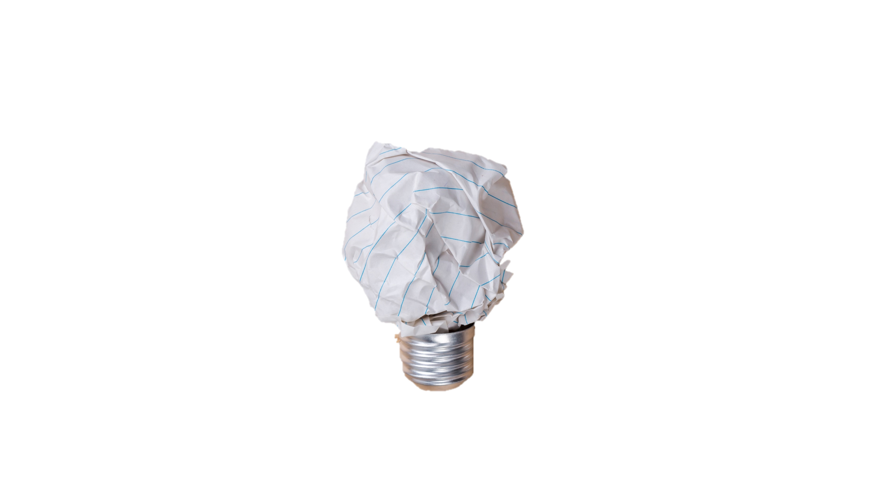
CREA TOPIA

Slide 2
1
ABOUT CREATOPIA

Slide 3
1
WEBSITE PURPOSE
Creatopia is a place for people showing off their creative works.
Designers, photographers, artists,… share small screenshots that show their work, process, and current projects.
The site is also a mean of entertainment, people can discover about creative world, seek for inspiration.
3

Slide 4
1
TARGET USERS
Web Designers
Artists
Photographers
Graphic Designers
Illustrators
Game Designers
Architects
Typographers
Creatives
4

Slide 5
2
STRUCTURE & DESIGN

Slide 6
2
WEBSITE DESIGN
Creatopia has a simple and minimal design.
The design is responsive for both smartphones and tablets.
There is one homepage, image displays and user profile pages.
5

Slide 7
2
DESIGN PROCESS
UI/UX & Mockups
Wireframe
Database
1
2
3
4
5
6
Front-end codes
Back-end codes
Testing
6

Slide 8
OUR TEAM
MINH TRI NGUYEN
JOONAS MIELONEN
HONG LOAN NGUYEN

